Slide 1

Key Derivation
Online Cryptography Course Dan Boneh
Odds and ends
生成密钥

Slide 2
Deriving many keys from one
secure session
unidirectional keys; multiple keys for nonce-based CBC.
Hardware random number generator（硬件随机数生成器）
A key exchange protocol（week5密钥交换协议）
generate many keys from this one source key
需求
源密钥（ source key (SK) ）来源
KDF（ Key Deriving Function ）目标
SK
k₁, k₂, k₃, …
KDF

Slide 3
When source key is uniform
均衡源密钥的KDF
如果源密钥是均匀分布的密钥空间中的一个随机密钥，KDF可以采用以下的形式：
F:a PRF ; L: Length
CTX: a string that uniquely identifies the application
CTX：环境变量（进程的上下文执行环境）
KDF( SK, CTX, L) :=
F(SK, (CTX ll 0)) ll F(SK, (CTX ll 1)) ll ⋯ ll F(SK, (CTX ll L))
K1
K2
K_{L + 1}

Slide 4
KDF( SK, CTX, L) :=
F(SK, (CTX ll 0)) ll F(SK, (CTX ll 1)) ll ⋯ ll F(SK, (CTX ll L))
需要参数CTX的原因
What is the purpose of CTX?
Even if two apps sample same SK they get indep. keys
It’s good practice to label strings with the app. name
It serves no purpose
同一程序不同进程，利用同一源密钥可以产生各自独立的密钥（CTX可以是进程号等）

Slide 5
What if source key is not uniform?
非均衡源密钥
Recall: PRFs are pseudo random only when key is uniform in K
SK not uniform ⇒ PRF output may not look random
Source key often not uniformly random:
Key exchange protocol: key uniform in some subset of K
Hardware RNG: may produce biased output
非均衡源密钥导致了PRF的输出也不是随机的
000000000001 低熵
101001101001 高熵
源密钥非均衡的原因
K
密钥交换协议追求生成高熵密钥（高熵意味着混乱度越高）
高熵
RNG(Random Number Generator)：输出存在误差

Slide 6
Extract-then-Expand paradigm
非均衡源密钥的KDF
Step 1: extract pseudo-random key k from source key SK
step 2: expand k by using it as a PRF key as before
Prob(概率)
extractor
prob
SK
k
salt
提取器并不产生均匀分布，而是生成与均匀分布不可分辨的分布
salt: a fixed non-secret string chosen at random

Slide 7
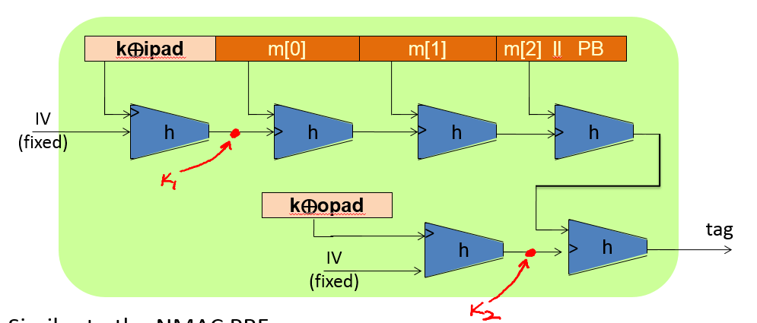
HKDF: a KDF from HMAC(6-5)
实现提取器（前提是SK熵值足够大）
Implements the extract-then-expand paradigm:
extract: use k ⟵ HMAC( salt, SK )
Then expand using HMAC as a PRF with key k
salt
K
SK

Slide 8
Password-Based KDF (PBKDF)
口令作为源密钥时的KDF
Deriving keys from passwords:
Do not use HKDF: passwords have insufficient entropy（熵值不够）
Derived keys will be vulnerable to dictionary attacks（字典攻击）
PBKDF defenses: salt and a slow hash function
Standard approach: PKCS#5 (PBKDF1)
H^{(c)}(pwd ll salt): iterate hash function c times
由于口令熵值不够，我们能做的就是让猜测其所生成密钥的难度尽可能大，从而减慢字典攻击
标准推荐的方法是加上盐值反复哈希

Slide 9
End of Segment

